Slide 1
Takaful in Africa
Huda Ahmed Yussuf (PhD)

Slide 2
Takaful Definition
Insurance in Islam has existed since the early second century of the Islamic era when Muslim Arabs expanding trade into Asia mutually agreed to contribute to a fund to cover mishaps or robberies along the numerous sea voyages. Muslim jurists concluded that insurance in Islam should be based on principles of mutuality and cooperation and encompass the elements of shared responsibility, joint indemnity, common interest and solidarity.
Takaful means an arrangement based on mutual assistance under which takaful participants agree to contribute to a common fund providing for mutual financial benefits payable to the takaful participant or to their beneficiaries on the occurrence of pre-agreed events.

Slide 3
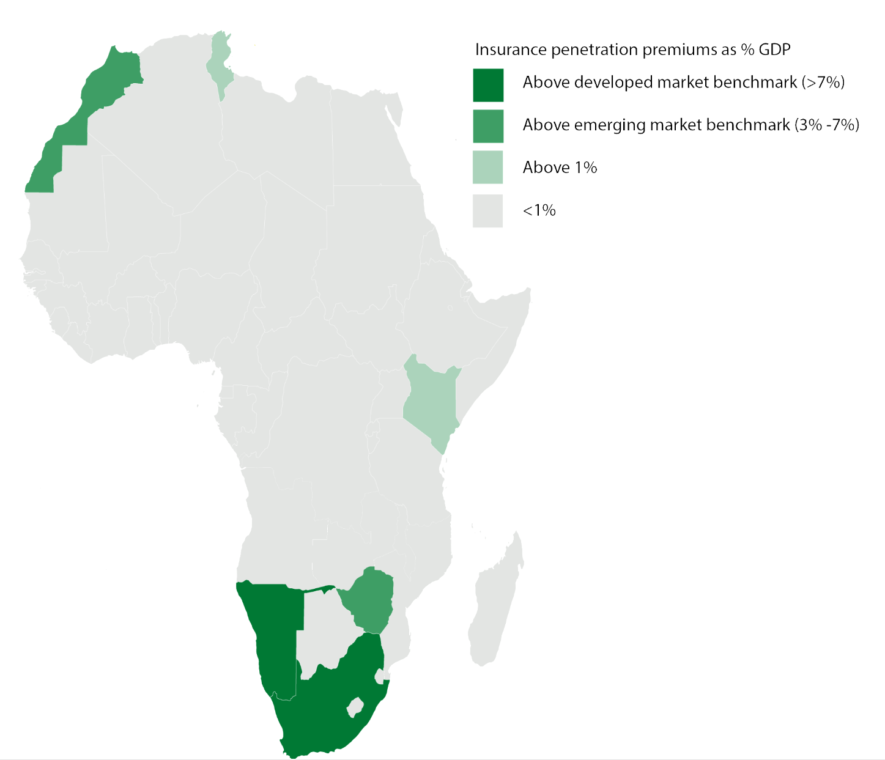
Insurance Demand in Africa
In 2019, Africa’s insurance premiums were valued at $68.15 billion. In 2019 Africa’s largest insurance market was South Africa, which accounts for approximately 69% of total premiums, followed by Morocco (6.6%), Kenya (3.3%), Egypt (2.8%) and Nigeria (2.4%)
With the exception of South Africa, insurance coverage in Africa is still very low, particularly in retail markets. Compared to the global average rate of 3.3 %, Africa’s non-life insurance penetration (premiums divided by GDP) in 2020 was only 1.8 %.
An ‘insurance culture’ does not yet exist in Africa, as most people have not been exposed to services that would credibly protect them against future loss.
Research indicates that most Africans do not trust either the financial ability or willingness of insurance companies to follow through with claims settlements99

Slide 4
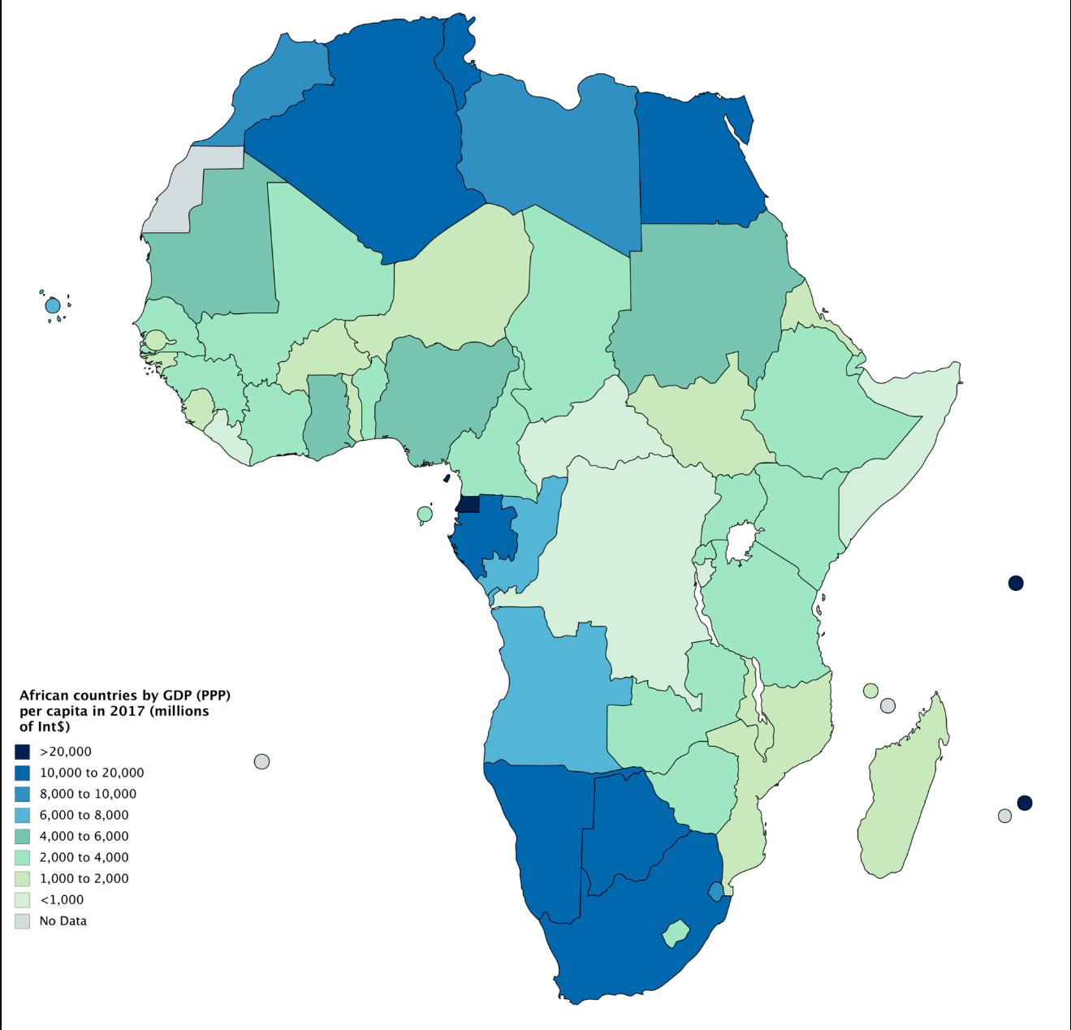
African Economic Status and Insurance
The African continent carries the second highest natural disaster risk of all continents, well above the world average and Asia, a continent often assumed to have a very high disaster risk. However, a closer look at the differences reveals that in Africa, vulnerability is much more important as a risk factor than exposure, with both vulnerability and the lack of adaptive capacity particularly low compared to other countries worldwide
education, dependency ratio and health expenditure as the significant demographic determinants of life insurance.
With respect to the financial variables, financial development was found to be the main driver of life insurance consumption in Africa.
Additionally, we find that increases in per capita income results in a decline in the life insurance consumption.

Slide 5
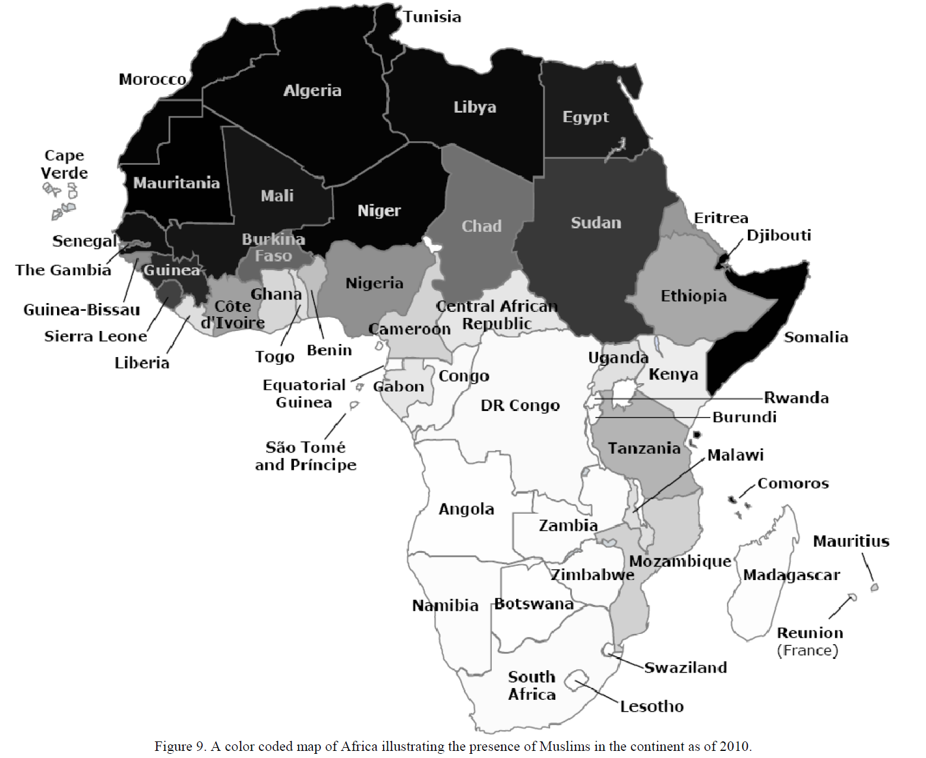
Muslim Population in Africa
Africa has approximately 40% Muslims
Nothern Africa --90%
West Africa ---55%
Upper Central Africa –45%
Lower Central –11%
Horn of Africa –31%
Southern Africa –5%

Slide 6
Status of Takaful in Africa
Sudan was the first country to establish Takaful Company in1976 and now Africa has total 51 Takaful Operators out of 336 Operators world wide.
Region | Presence of Takaful Operators | Presence of Takaful Regulations
North Africa | All | All except Libya and Mauritania
West Africa | 5 out 10 | Most are CIMA (Inter-African Conference of Insurance Markets) observer
Upper Central Africa | 2 to 4 out of 7 | 2 out of 7
Horn of Africa | All except Eritrea (4 out 5) | 3 out of 5 with Somalia being regulated by Central Bank
Lower Central | 2 out of 9 (inclusive of Tanzania) | 2 out of 9
Southern Africa | 3 out of 11 | 1 out of 11 (South Africa)

Slide 7
How Takaful can benefit Africa
In Africa, traditional “self-insurance” tools designed to collectively transfer and manage risks often take the form of community savings supervised by a “wise” person, or more com­plex hierarchical and social arrangements. Pooling risks and resources to help people through tough times is very common in Africa.
Regulated Cooperative insurers are in a better position than others to serve the poor
While Takaful on its own is not the solution to the poverty problem, it has to be recognized as an important component of any poverty alleviation strategy. Without protection against losses and natural perils many individuals find themselves regularly falling back into poverty, which is not only disheartening but also renders development assistance ineffective in the long term. Takaful can provide the safety net for communities to achieve sustainable development of their standard of living, providing a basis for families to look to the future with a sense of security and optimism.

